Slide 1
Automated Bugs Identification Through Early Access Game Review Analytics On Game Distribution Platforms
ALI SHAHBAZ(20I-2020)
DR. KHUBAIB AMJAD ALAM

Slide 2
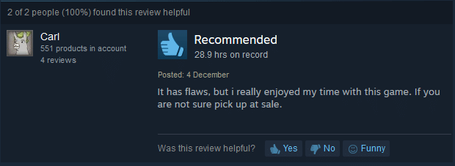
Research Background
The game industry has become one of the most profitable markets in the entertainment industry. Knowing what customers and users think and how they feel about a game is a central piece to drive the decision making process of any game developer or game studio, towards the user satisfaction [1]. Developing a successful game is challenging. Studying gamer reviews help developers better understand the concerns and further improve the user perceived quality.

Slide 3
Motivation
Reviews are helpful for developers to resolve issues and identify requirements to meet the end user’s expectations.
Manual analysis is impractical for a large number of reviews, received every day.
App-reviews-mining has followed the Text Mining approaches to extract valuable information from the reviews, by these approaches developers are able to detect feature requests, user responses and gaming bugs.
Initial work had limited to the identification of the game bugs related categories but limited scientific work exist on automated bug identification and classification.

Slide 4
Motivation
Although automated bug identification from game reviews are inherently a multi-level and multi-label classification problem. However existing studies have rather focused on relatively simpler problem formulation.
One review can fall in more then one categories of bugs e.g. one review can contain both the bugs of invalid positioning and artificial stupidity.
There is a need of automated mechanism which can take user reviews as an input then after training and modeling the data it can classify bugs into their related categories.

Slide 5
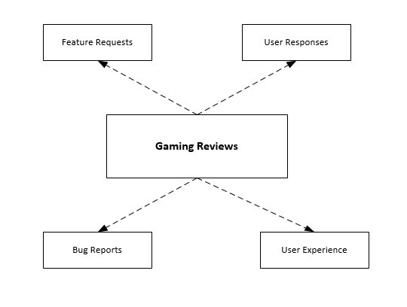
Gaming Reviews

Slide 6

Review example of EAG(Early Access Games) on STEAM ENGINE

Slide 7
Introduction
The steadily increasing popularity of computer games has led to the rise of a multi-billion-dollar industry.
Prior studies show that gamers are extremely hard to please, making the quality games an important issue.
Reviews can make or break a game [5], as other potential buyers often base their purchasing decisions on the reviews of a game.
Bugs that persist into releases of video games can have negative impacts on both developers and users.
Studying gamer reviews help developers better understand the concerns and further improve the user perceived quality.

Slide 8
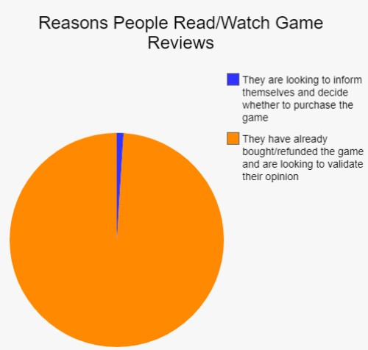
Introduction

Slide 9
Research Methodology
Defining objectives of
the solution
Literature Review for research gap
analysis and
construction of an
initial list of
evaluation factors
Design and
development of the multiple deep learning model for multi-label classification model of reviews
Evaluation of the
proposed approach
to determine its
applicability in the
context of real world mobile applications

Slide 10
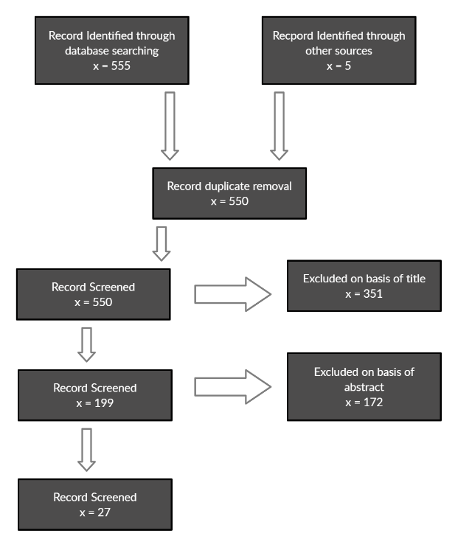
Study Selection Procedure

Slide 11
Research Objectives
RO1: To gain insights of the existing classification methods that need to be addressed in the context of game rating analysis.
RO2: To evaluate the performance of deep learning models for multi-label text classification.
RO3: To automatically categorize gaming reviews into multiple bugs labels using deep learning models (CNN, RNN & LSTM).

Slide 12
Research Questions
RQ1: What is the most widely used classification approach for game reviews analysis?
RQ2: What are gamers talking about in gaming reviews?
RQ3: How do feature extraction impact the performance of deep learning classification models for gaming reviews?
RQ4: How reviews can be categorized into multiple labels using deep learning approaches CNN, RNN & LSTM?

Slide 13
Literature Review
Ref. No., Year | Methodology/Approach | Strengths | Weaknesses | Dataset used
[1] | Data mining based techniques (Mine the review based on phrases). | User opinions in reviews Phrases from reviews | Approach cannot extract opinions corresponding to textual expressions No classification and categorization of bugs | 120 mobile apps, 2944,335 crawled reviews
[2] | Statistical Method (Pearson’s chi-squared test) | Simplifying bug reports Classification of bugs into four categories | Focused on simplifying bug reports Fewer bug reports mentioned | NetBeans and Apache Software Foundation project
[5] | Deep Learning algorithms (Deep enforcement learning DRL’s) | Navigation of FPS type games, Game exploits and bugs, distribution of visited states, and difficulty evaluation | Limited to FPS games Not all problems can be solved by RL(Reinforcement learning) technique including bugs classification and categorization | N/A
[3] | Deep Learning algorithms (sentiment analysis techniques) | Classification of app reviews into four types Bug reports, feature requests, user experiences, and text ratings | Limited to bug reports, feature only no method for bug classification | 1186 apps and 1,303,182 reviews
[4] | Static method unity linter tool | Unity games and projects | Static analysis is not particularly used to finding bugs in games No classification of bugs | 100 open source unity projects

Slide 14
Literature Review
[6] | Statistical Method (Wilcoxon signed rank test) | Similarity check between game reviews characteristics with mobile app reviews characteristics | Only collected one month of reviews that have an accurate number of playing hours | 6224 applications
[7] | Unity test tool | Testing of mobile game using unity tool | Only tested for application which is developed on unity engine No any report and identification of bugs | XYZ game
[12] | Game loop video | XML written template which generates a message based on game’s current state | GUI need to be reprogrammed for every game Detection of bugs in real time but no explanation for its classification | Five real world games
[8] | Supervised Machine Learning algorithms (Model based testing) | Model based testing to model the conceptual and behavioral details to be tested | Focused only on functional testing of the game Developers have to develop separate test ready models | 2D and 3D games
[13] | Statistical Method (Descriptive statistical method) | User reviews to understand user requirements from store Aggregation and use of feedback | No identification of bugs from user reviews | App Store application reviews (1126453)

Slide 15
Literature Review
[9] | Supervised Machine Learning algorithms (random forest classifier) | Game play videos from steam platform and YouTube, used videos meta data and compare it with keywords to identify bug videos | Limited to videos data Not able to detect bugs from textual data | 1400 Game Play Videos Labeled dataset of 96 videos
[14] | Stratify app model | Grouping of reviews based on user concerns User general sentiment on each entity User review classification | No classification of bugs | 6 Apps (Virtual table tennis, bubble shooter, Quota, Tumblr, YouTube, Speaker Boost) Game(285,091),Social(21,773,29),Media(11,646,981)
[10] | Divide-and-conquer | Possible failures in games and division in temporal and non-temporal failures, categorization of bugs | No tool to automate the process Taxonomy to just classify the bugs into different categories | YouTube videos as dataset
[11] | Statistical Method Tool (cosine similarity measure) | Bug fixes taken from app updates, Frequency of bugs in games | Manually evaluated these fixes to find the true recurring bugs | 30 Games, 12,122 bugs

Slide 16
Problem Statement
Several research studies have been conducted to mine and categorize user-reviews into actionable software maintenance requests, including feature requests and bug reports. Existing literature has focused on user response toward games, detection of bugs in reviews.
But there is need of an automated tool which can mine the reviews and extract bugs from it and then classify them in to bugs categories and then generate bug reports from it.
Existing studies have either focused on mere identification of bug categories, or coverage of limited set of bug classes/categories. Comprehensive coverage of diverse set of bug categories such as lag, freezing, save glitch etc, is non-existent in the extant literature.

Slide 17
Game Reviews Dataset
We used STEAM ENGINE gaming platform for the collection of gaming reviews of different early access games of multiple categories. We had developed custom scraper which can crawl the reviews of any game from STEAM ENGINE using the unique ID of the game.
Game reviews scraper details:
We used SCRAPY(fast high-level web crawling and web scraping framework, used to crawl websites and extract structured data from their pages) spiders for the scrapping of reviews from the STEAM ENGINE. The features implemented are as follow:
Extract useful metadata from STEAM PRODUCT LISTING.
It scrape all user-submitted reviews of a particular product from the Steam community portal.
Automatically navigates through Steam's age verification checkpoints.

Slide 18
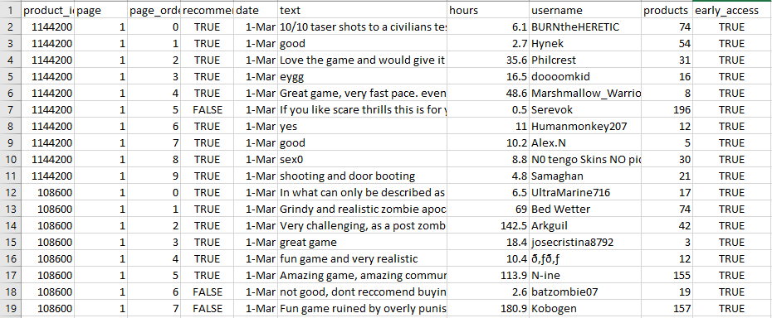
Game Reviews Dataset
Below is the image of scrapped game reviews using SCRAPY

Slide 19
Dataset Labelling
As reviews labelling was required for gaming bugs classification in order to train a deep learning model. So we selected 10,000 gaming reviews of 15 different games of different categories and get them labelled from multiple gaming experts, who play games on daily basis and like to review the games.
Labelling Mechanism:
Labeling of reviews in fifteen different bugs categories of games j.Lewis taxonomy [10].
Reviews are labelled with corresponding bugs categories in the form of 0 and 1.

Slide 20
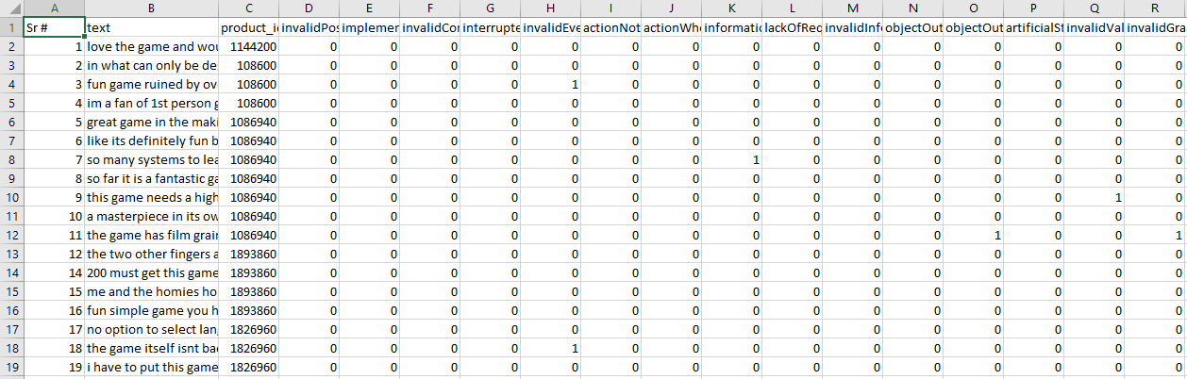
Game Reviews Labelled Dataset
Below is the image of gaming bugs labelled dataset.

Slide 21
Pilot Studies
Multiple deep learning approaches are available for multi label text classification. But which perform best for the multi label text classification was unknown. We conducted the pilot studies of three different multiple deep learning models which are mostly used in literature for multi-label classification of reviews on 1500 gaming reviews dataset. The models used for pilot studies are:
RNN(Recurrent neural network)
LSTM(Long short-term memory)
CNN(Convolutional neural network)

Slide 22
1. RNN(Recurrent neural network)
A Recurrent Neural Network (RNN) is a type of neural network in which the output of the previous step is provided as the input of the current step. It is feed forward model. RNN is mainly used for sequence classification - sentiment classification and video classification.
Implementation Steps:
Data set was divided into train set, validation set & test set.
GloVe embedding is used to implement word embedding.
Before word embedding data is Pre-processed.
Parameters are initialized which include input dimension, embedding dimension, hidden dimension, output dimensions and word embedding.
At first hidden state set to all zeros.
Mapped all indexes present in the input sequence of corresponding word vectors using our trained word embedding.

Slide 23
1. RNN(Recurrent neural network)
Model is later saved to test it for the real world input and calculated the accuracy which is shown in the below table:
Epochs | Accuracy | Val-Accuracy
1 | 0.6104 | 0.6000
2 | 0.6201 | 0.6198
3 | 0.6202 | 0.6101
Average | 0.6169 | 0.6099

Slide 24
2. LSTM(Long short-term memory)
LSTMs work much better due to hold over memorizing certain memory patterns. Like other neural networks, LSTMs can have multiple hidden layers, and as you go through each layer, that information is stored and all the insignificant information in each cell is thrown away.
Implementation Steps:
LSTM receives five arguments and have four dimensions. Four layers include
Output-Dim (Output layer: number of nodes in output layer will be same as input layer).
Hidden-Dim (Hidden layer: size of hidden layer. It the size of hidden-start of the LSTM).
Input-Dim (Total number of unique word in sample data).
Embedding-dim (Size of each embedding vector. Here embedding dimension of GloVe word embedding vectors is 100).

Slide 25
2. LSTM(Long short-term memory)
The results for the model accuracy for 1500 reviews for 3 epochs are given in the table below:
Epochs | Accuracy | Val-Accuracy
1 | 0.6404 | 0.6400
2 | 0.6401 | 0.6498
3 | 0.6402 | 0.6401
Average | 0.6402 | 0.6433

Slide 26
3. CNN(Convolutional neural network)
CNN is a type of artificial neural network, which is widely used for image/object recognition and classification. Deep Learning thus recognizes objects in an image by using a CNN. It can also be modified for multi-label text classification.
We customized it in multi-label bug classification model which specifies that:
Number of label matches the number of nodes on output layer.
Activation function Sigmoid is used for each node in the output layer.
Binary Cross-entropy loss function to compare each of the predicated probabilities to actual class output which can be 0 or 1.
Implementation Steps:
Three layers of model are used which include pooling layer, convolutional layer and last one is the fully connected layer.

Slide 27
3. CNN(Convolutional neural network)
In the first layer which is pooling layer, dimensions of the feature map are reduced.
In the convolutional layer, filter map is applied on original dataset to feature maps in CNN model.
Fully connected layer contained the final model output which have connected nodes with the output labels.
The results of the 3 epochs for the testing data set of 1500 reviews are presented in the below table:
Epochs | Accuracy | Val-Accuracy
1 | 0.4904 | 0.4900
2 | 0.5001 | 0.4993
3 | 0.5002 | 0.5000
Average | 0.4969 | 0.4963

Slide 28
Proposed Research Methodology
We are using steam game platform as a case study to collect reviews of different games using a custom crawler.
Pre-processing is done for a textual data to make it clean and ready for analysis.
Labelling of dataset by gaming experts.
NLP techniques including stop words removal, lemmatization and tokenization are used to process raw text of user reviews.
Then deep learning based multi-label review classifier LSTM is implemented for classification of reviews into defined set of labels.
Model is later tested and evaluated using real world example reviews.

Slide 29
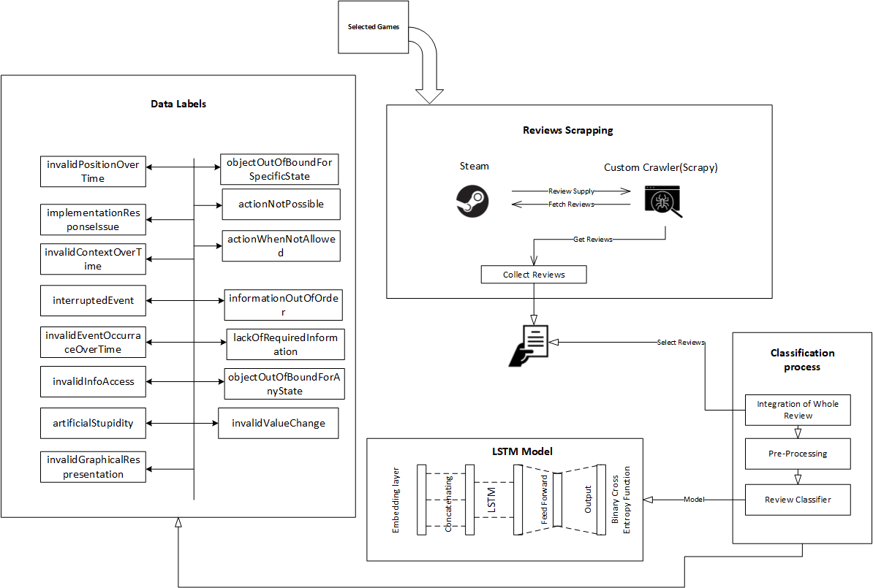
Architecture Of The Proposed Approach

Slide 30
Classification Process
Classification process is comprises of three fundamental steps :
Pre-Processing
Classification Model
Validation

Slide 31
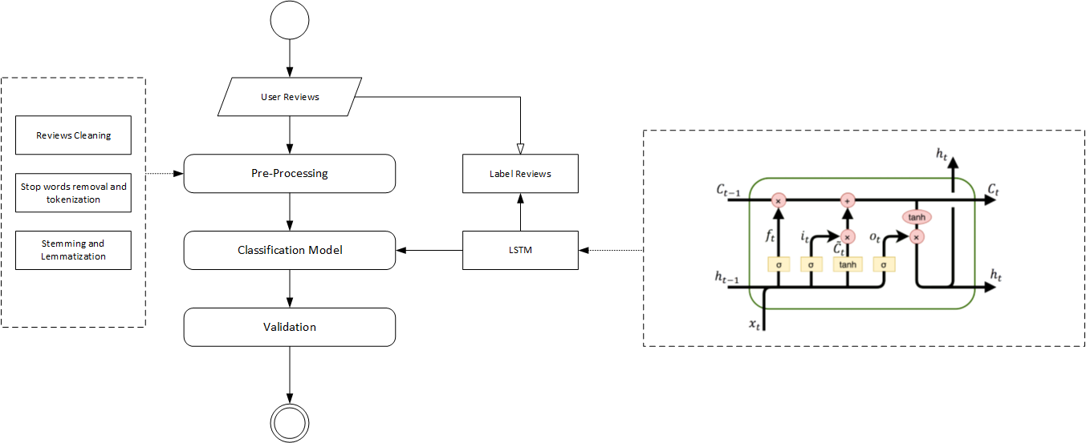
Generic process view of reviews classification approach

Slide 32
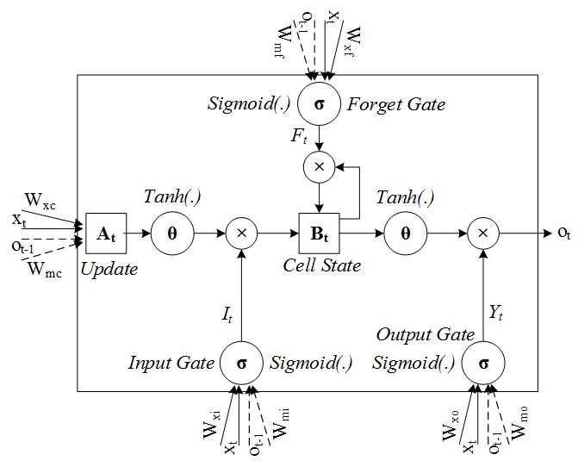
LSTM Architecture
It basically consist of four gates:
Forget gate
Input gate.
Cell state
Output gate

Slide 33
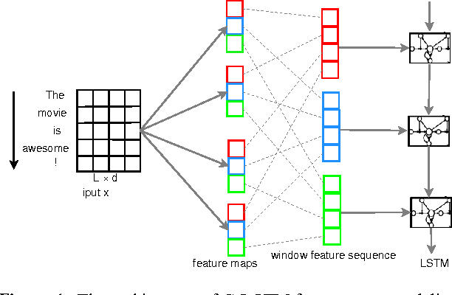
Model Design
The proposed LSTM model working is shown in figure. LSTM receives five arguments and have four dimensions.
It’s four layers include
Output-Dim (Output layer: number of nodes in output layer will be same as input layer).
Hidden-Dim (Hidden layer: size of hidden layer. It the size of hidden-start of the LSTM).
Input-Dim (Total number of unique word in sample data).
Embedding-dim (Size of each embedding vector. Here embedding dimension of GloVe word embedding vectors is 100).

Slide 34
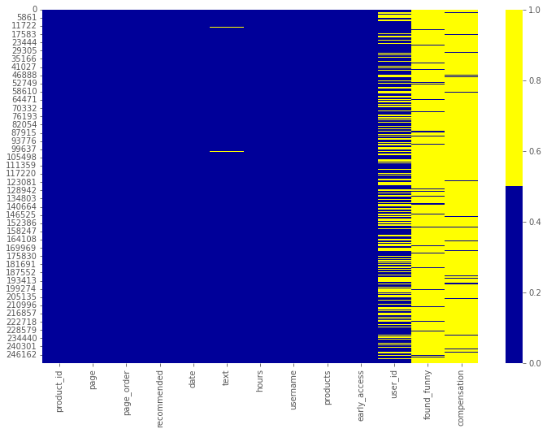
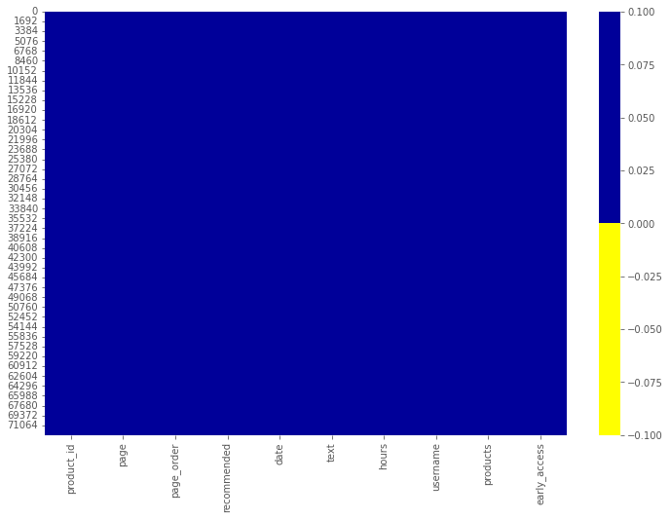
Implementation and Evaluation
Before the implementation of LSTM model, we analyze the dataset to draw results and identify its shape. For this purpose, reviews are labelled into fifteen bugs categories which are proposed in j.Lewis taxonomy. [7]
The dataset contains 10,000 reviews of 15 games. Dataset is cleaned and pre-processed before passing it to training model.
Before Cleaning
After Cleaning

Slide 35
Implementation and Evaluation
After pre-processing of the reviews deep learning model LSTM is trained over the ten thousand reviews dataset. Initially model is trained on 1500 reviews as described in pilot study in chapter 3. Later model is trained over 10,000 labelled reviews in which 8000 reviews are used for training and 2000 reviews are used for validation(80/20 rule).
Detailed results of each epoch (hyper parameter that defines the number times that the learning algorithm will work through the entire training dataset) are shown in below table.
Epochs | Accuracy | Val-Accuracy
1 | 0.8234 | 0.8219
2 | 0.8237 | 0.8222
3 | 0.8344 | 0.8329
Average | 0.8271 | 0.8256

Slide 36
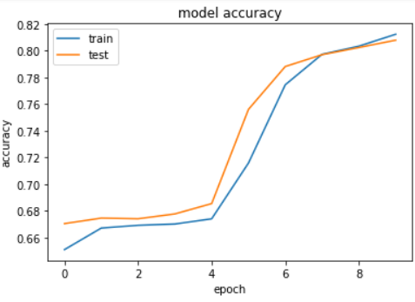
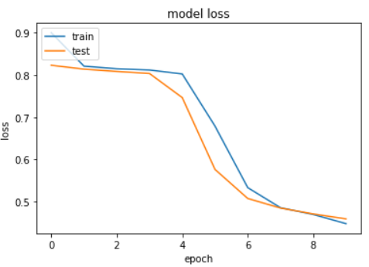
Model Accuracy and Loss

Slide 37
Research Contribution
Multi-label bug classification model for gaming app reviews has developed to support both game developers and researchers.
Extraction of bugs from the reviews helps developers and gaming companies to make improvements in games.
It helps them to get the information about the issues that gamers are facing while playing the games.
Gamers express more than one issue in a single review which can be solved by this proposed solution.

Slide 38
Limitation and future work
In the context of ongoing work the proposed multi-label bug classification model focuses mainly on classifying the bugs into fifteen categories which are defined in existing literature [10].
Number of epochs are set to minimum which can also be increased to achieve the better results.
GloVe word embedding technique however other embedding techniques like word2Vec can also be used.
The proposed model is evaluated on the basis of accuracy other factors can also be considered to measure its performance.
Gaming bugs labeled dataset can be used for other research purposes too.

Slide 39
Conclusion
Existing literature have very serious limitations in terms of multi-label classification of bugs in gaming industry.
Most of the existing literature is limited to abstract level of bugs classifications.
Automated model for the classification of multi-label gaming reviews is rarely seen.
For automated multi-label bugs classification of gaming reviews this research implies machine learning based models and deep learning based models such as CNN, RNN and LSTM.
On the basis of results accuracies of pilot studies an automated multi-label bug classification model LSTM is implemented using python with fifteen different games and 10,000 reviews dataset.
To classify the bugs into multi label classification different objectives were defined and proved on the course of this research.

Slide 40
References
[1] P. M. Vu, H. V Pham, T. T. Nguyen, and T. T. Nguyen, “Phrase-based extraction of user opinions in mobile app reviews,” in 2016 31st IEEE/ACM International Conference on Automated Software Engineering (ASE), 2016, pp. 726–731.
[2] M. Nayrolles and A. Hamou-Lhadj, “Towards a classification of bugs to facilitate software maintainability tasks,” Proc. - Int. Conf. Softw. Eng., pp. 25–32, 2018, doi: 10.1145/3194095.3194101.
[3] W. Maalej, Z. Kurtanović, H. Nabil, and C. Stanik, “On the automatic classification of app reviews,” Requir. Eng., vol. 21, no. 3, pp. 311–331, 2016, doi: 10.1007/s00766-016-0251-9.
[4] A. Borrelli, V. Nardone, G. A. Di Lucca, G. Canfora, and M. Di Penta, “Detecting Video Game-Specific Bad Smells in Unity Projects,” Proc. - 2020 IEEE/ACM 17th Int. Conf. Min. Softw. Repos. MSR 2020, pp. 198–208, 2020, doi: 10.1145/3379597.3387454.
[5] J. Bergdahl, C. Gordillo, K. Tollmar, and L. Gisslén, “Augmenting Automated Game Testing with Deep Reinforcement Learning,” in 2020 IEEE Conference on Games (CoG), 2020, pp. 600–603, doi: 10.1109/CoG47356.2020.9231552.
[6] D. Lin, C. P. Bezemer, Y. Zou, and A. E. Hassan, An empirical study of game reviews on the Steam platform, vol. 24, no. 1. Empirical Software Engineering, 2019.

Slide 41
References
[7] A. C. Barus, R. Deddy Hasiholan Tobing, D. N. Pratiwi, S. A. Damanik, and J. Pasaribu, “Mobile game testing: Case study of a puzzle game genre,” Proc. 2015 Int. Conf. Autom. Cogn. Sci. Opt. Micro Electro-Mechanical Syst. Inf. Technol. ICACOMIT 2015, pp. 145–149, 2016, doi: 10.1109/ICACOMIT.2015.7440194.
[8] S. Iftikhar, M. Z. Iqbal, M. U. Khan, and W. Mahmood, “An automated model based testing approach for platform games,” in 2015 ACM/IEEE 18th International Conference on Model Driven Engineering Languages and Systems (MODELS), 2015, pp. 426–435, doi: 10.1109/MODELS.2015.7338274.
[9] D. Lin, C. P. Bezemer, and A. E. Hassan, “Identifying gameplay videos that exhibit bugs in computer games,” Empir. Softw. Eng., vol. 24, no. 6, pp. 4006–4033, 2019, doi: 10.1007/s10664-019-09733-6.
[10] C. Lewis, J. Whitehead, and N. Wardrip-Fruin, “What went wrong: A taxonomy of video game bugs,” FDG 2010 - Proc. 5th Int. Conf. Found. Digit. Games, pp. 108–115, 2010, doi: 10.1145/1822348.1822363.
[11] A. Truelove, E. S. de Almeida, and I. Ahmed, “We’ll Fix It in Post: What Do Bug Fixes in Video Game Update Notes Tell Us?,” in 2021 IEEE/ACM 43rd International Conference on Software Engineering (ICSE), 2021, pp. 736–747, doi: 10.1109/ICSE43902.2021.00073.

Slide 42
References
[12] S. Varvaressos, K. Lavoie, A. B. Massé, S. Gaboury, and S. Hallé, “Automated Bug Finding in Video Games: A Case Study for Runtime Monitoring,” in 2014 IEEE Seventh International Conference on Software Testing, Verification and Validation, 2014, pp. 143–152, doi: 10.1109/ICST.2014.27.
[13] D. Pagano and W. Maalej, “User feedback in the appstore: An empirical study,” in 2013 21st IEEE International Requirements Engineering Conference (RE), 2013, pp. 125–134, doi: 10.1109/RE.2013.6636712.
[14] Y. Liu, Y. Li, Y. Guo, and M. Zhang, “Stratify Mobile App Reviews: E-LDA Model Based on Hot ‘Entity’ Discovery,” in 2016 12th International Conference on Signal-Image Technology & Internet-Based Systems (SITIS), 2016, pp. 581–588, doi: 10.1109/SITIS.2016.97.

